Slide 1
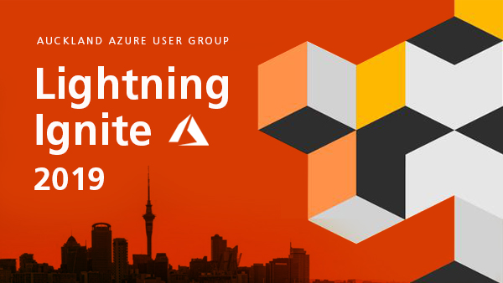
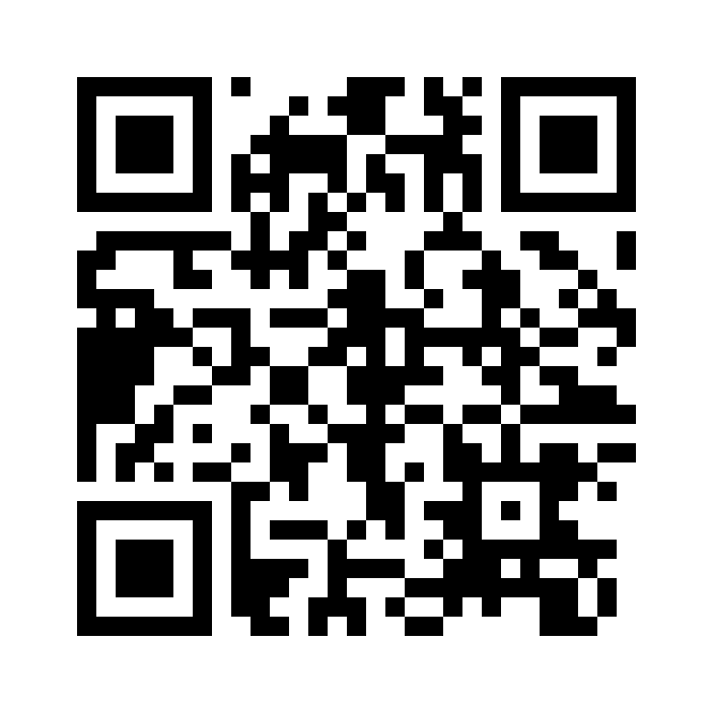
Slide Pack
20th November 2019
https://aka.ms/aaug

Slide 2
Agenda
Kick-off and Housekeeping – Rory Braybrook
AAD & B2C - Rory Braybrook
Azure Arc – Buddy Davies
Azure Synapse – Dave Theunissen
Microsoft Power Virtual Agents – Alessandro Moura
API Management Arc Enabled – Wagner Silviera
ADF Data Mapping – Sudhir Rawat
Visual Studio Online – Jaliya Udagedara
Q & A and Giveaways - Speakers
Wrap Up – Buddy Davies

Slide 3
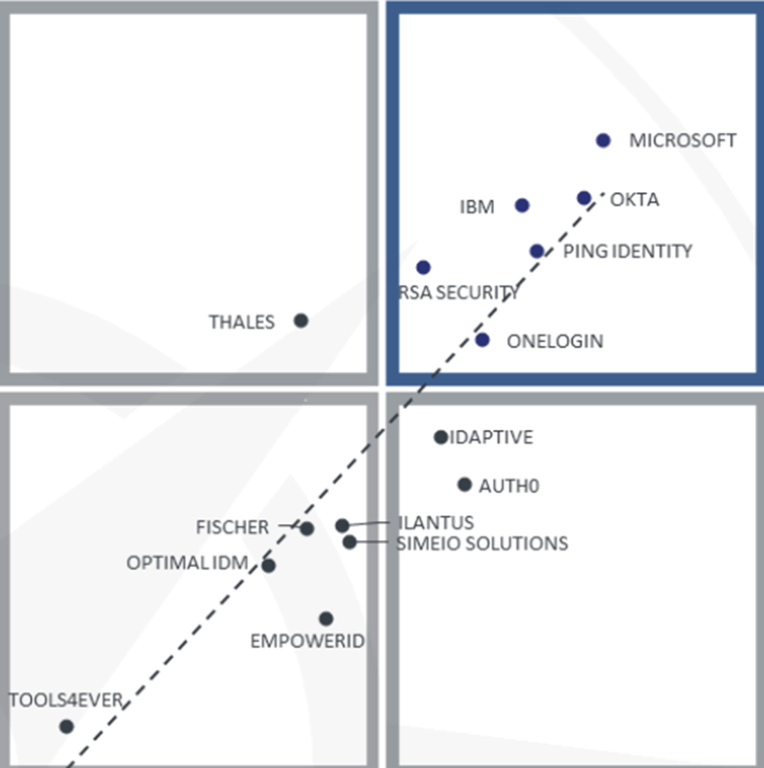
Rory – AAD & B2C
Notes:
1: Address compliance issues by running your workloads on hosts dedicated to your Azure Tenant. Normally when you provision a VM, its on a multi-tenanted host right. So with other Azure customers workloads.
2: You can provision a host group and add dedicated hosts to it within a region or even an availability zone. Same applies for fault domains, so different racks, power etc within an Azure DC.
3: Windows Server Datacenter licenses and Software Assurance can use unlimited virtualization rights in Azure Dedicated Hosts.
4: Allows you to control the maintenance of your dedicated hosts – You currently have to apply to try this preview feature and can defer up to 35day before your forced to apply the maintenance.
5: A current limitation is your can only provision workloads from a particular VM family. You pick which one when you provision: ESv2 or DSv3.

Slide 4
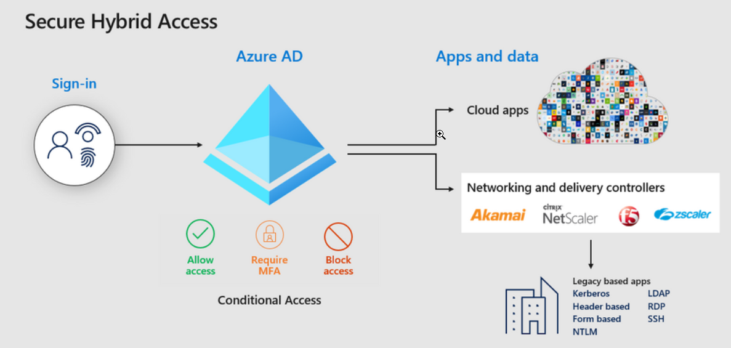
Rory – AAD & B2C
Notes:
1: Address compliance issues by running your workloads on hosts dedicated to your Azure Tenant. Normally when you provision a VM, its on a multi-tenanted host right. So with other Azure customers workloads.
2: You can provision a host group and add dedicated hosts to it within a region or even an availability zone. Same applies for fault domains, so different racks, power etc within an Azure DC.
3: Windows Server Datacenter licenses and Software Assurance can use unlimited virtualization rights in Azure Dedicated Hosts.
4: Allows you to control the maintenance of your dedicated hosts – You currently have to apply to try this preview feature and can defer up to 35day before your forced to apply the maintenance.
5: A current limitation is your can only provision workloads from a particular VM family. You pick which one when you provision: ESv2 or DSv3.

Slide 5
Rory – AAD & B2C
All customers can now enable MFA for free with the Microsoft Authenticator app.
Conditional Access report-only mode is now in public preview. It allows administrators to evaluate potential impact of new policies before rolling them out across the entire organization
The Global Reader role along with 15 other roles rolled out in public preview last month for further visibility into settings and policies without added risk.
Azure AD entitlement management is now generally available!
Public preview of inbound user provisioning from SAP SuccessFactors
Staged rollout to cloud authentication is now available in public preview
Firstline Worker – log in with phone number and code
Notes:
1: Address compliance issues by running your workloads on hosts dedicated to your Azure Tenant. Normally when you provision a VM, its on a multi-tenanted host right. So with other Azure customers workloads.
2: You can provision a host group and add dedicated hosts to it within a region or even an availability zone. Same applies for fault domains, so different racks, power etc within an Azure DC.
3: Windows Server Datacenter licenses and Software Assurance can use unlimited virtualization rights in Azure Dedicated Hosts.
4: Allows you to control the maintenance of your dedicated hosts – You currently have to apply to try this preview feature and can defer up to 35day before your forced to apply the maintenance.
5: A current limitation is your can only provision workloads from a particular VM family. You pick which one when you provision: ESv2 or DSv3.

Slide 6
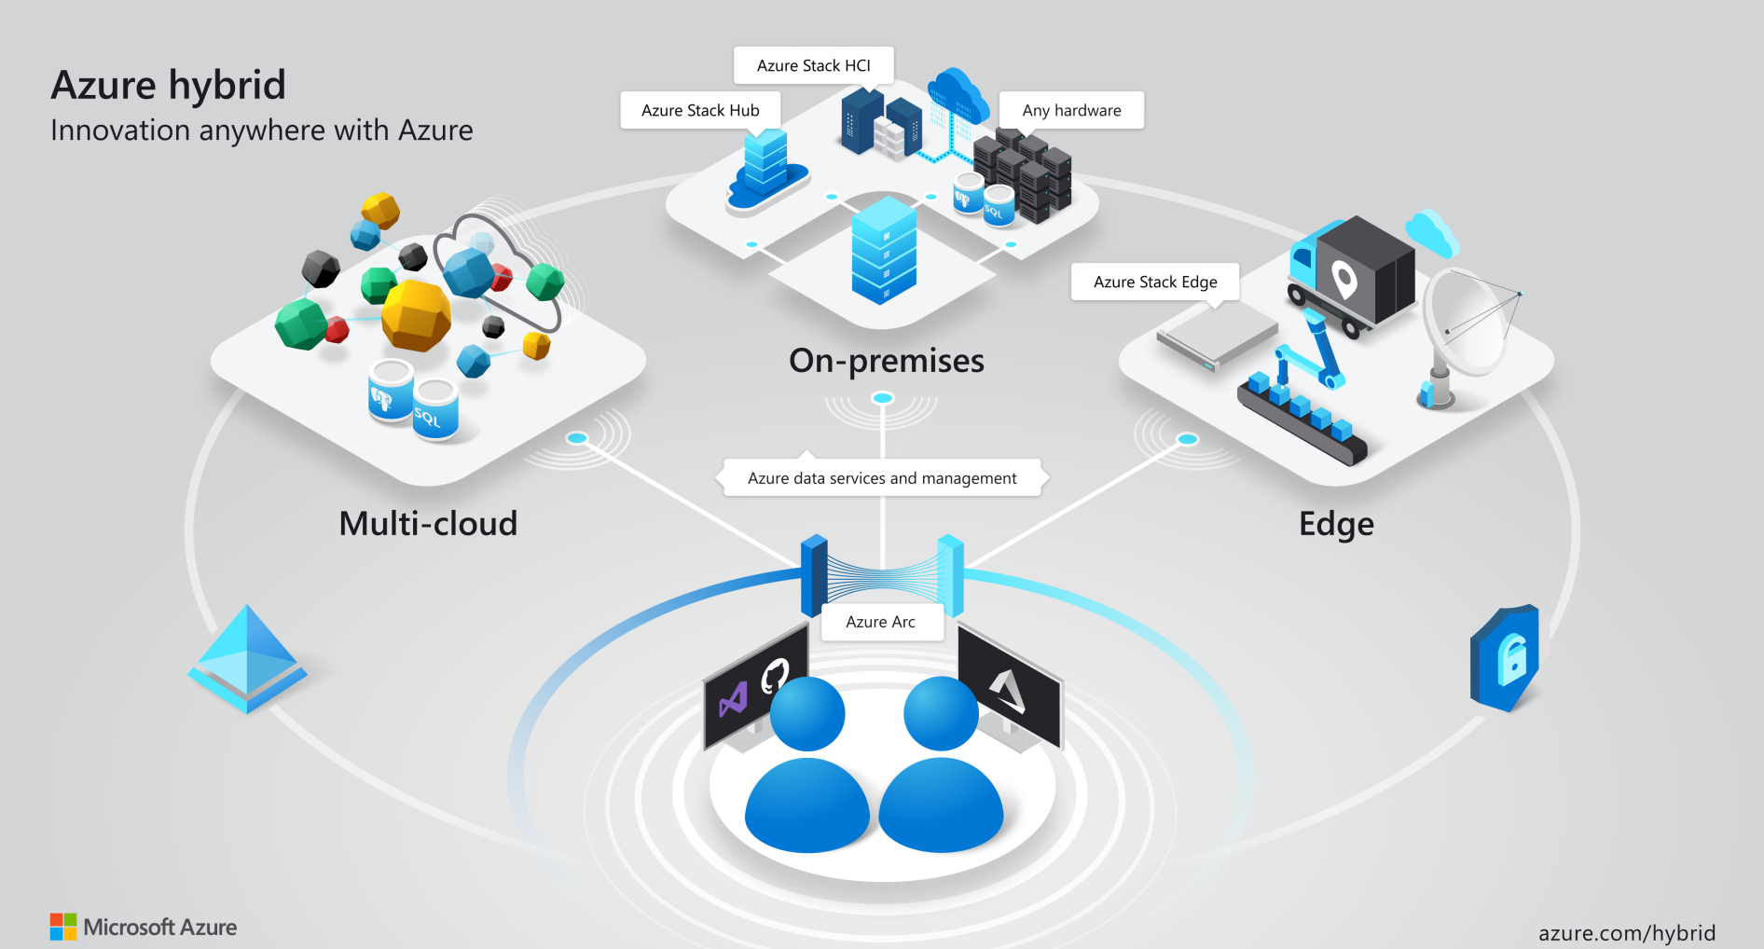
Notes:
Who here manages workloads across On-Prem and Azure?
What about across multiple cloud platforms?
The Ignite announcements included one around some extension capabilities for hybrid cloud solutions in Azure by way of a new service called Azure Arc.
This is a service currently in preview and at its highest level is designed to extend Azure Management to any infrastructure platform. Physical, Vm’s, K8s, GCP, AWS, On prem.
If you work somewhere in which hybrid cloud or multi-cloud is a reality, then you will probably agree that its easy to have a disconnect between platforms when it comes to managing, governing and operating workloads such as
VM’s, data services & container platforms like Kubernetes.
Naturally, these technologies and the cloud platforms available each do things in different ways. So its kind of expected.
Azure Arc allows you to have those Azure management capabilities that you know well and use daily Across any infrastructure
And also allows you to run Azure data services such as Azure SQL DB or Azure Database for PostGres to be deployed anywhere.

Slide 7
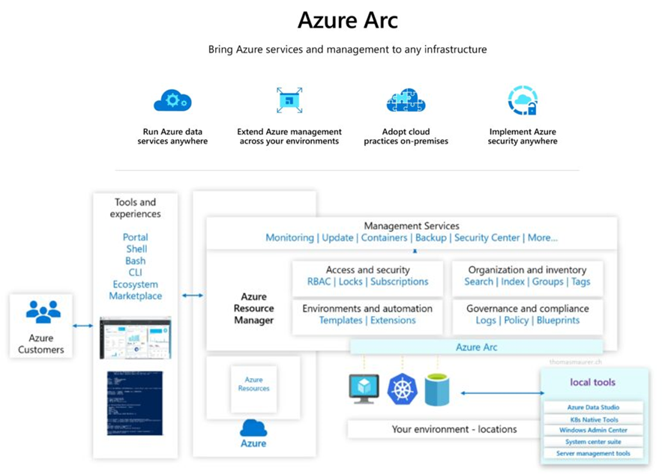
Notes:
So at its core – its enabling you to do some real critical things across all your infrastructure.
Organize and govern all your servers – Integrate your workloads across platforms into azure, collect telemetry into Log Analytics, have those workloads be subject to Azure Policies for governance. Sort with resources groups and tagging.
Manage Kubernetes apps at scale – This is cool, you can integrate Kubernetes clusters into Azure Arc that are operating on different platform and then manage, deploy and configure your services / applications consistently across them through Devops tooling.
Run data services anywhere – This one is real interesting and why I want to get some time to play with Arc properly
---- You can run Azure Data Services such as Azure SQL Database or Azure Database for Postgres as a container on your infrastructure & manage it from Azure Arc.
Once you have joined the preview you can get started right away with just a few steps with:
Register the resource providers for Hybrid compute and Guest Config
Onboard servers through the Azure Arc service - - -
this is where you complete some details on a form,
get script to run on your workload and int’ll hook into Azure as a resource ready for management.
There is not a whole lot of documentation yet but I would imagine it will rapidly come over the coming weeks. So in the mean time id recommend watching some of the ignite demo’s on Youtube and sign up to the Preview.
We will aim to make this a topic on the first user group back in 2020.

Slide 8
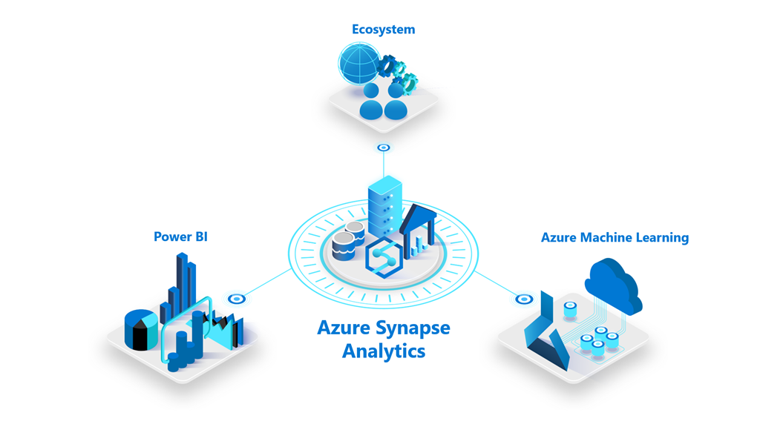
Dave – Azure Synapse
Notes:
1: Address compliance issues by running your workloads on hosts dedicated to your Azure Tenant. Normally when you provision a VM, its on a multi-tenanted host right. So with other Azure customers workloads.
2: You can provision a host group and add dedicated hosts to it within a region or even an availability zone. Same applies for fault domains, so different racks, power etc within an Azure DC.
3: Windows Server Datacenter licenses and Software Assurance can use unlimited virtualization rights in Azure Dedicated Hosts.
4: Allows you to control the maintenance of your dedicated hosts – You currently have to apply to try this preview feature and can defer up to 35day before your forced to apply the maintenance.
5: A current limitation is your can only provision workloads from a particular VM family. You pick which one when you provision: ESv2 or DSv3.

Slide 9
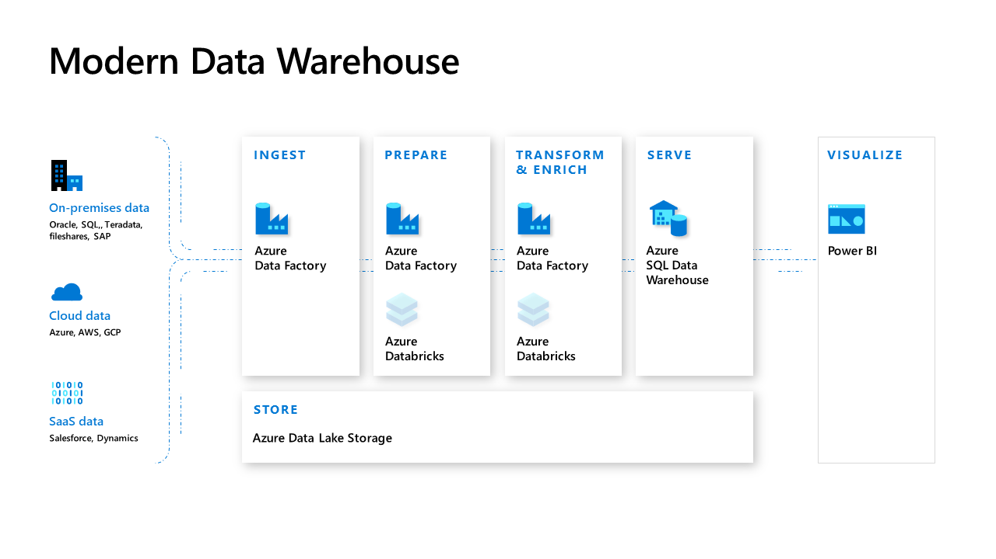
Modern Azure Analytics Platforms
Azure Data Factory
Azure Data Lake
Azure Databricks
Azure SQL / SQLDW
Azure Data Catalogue

Slide 10
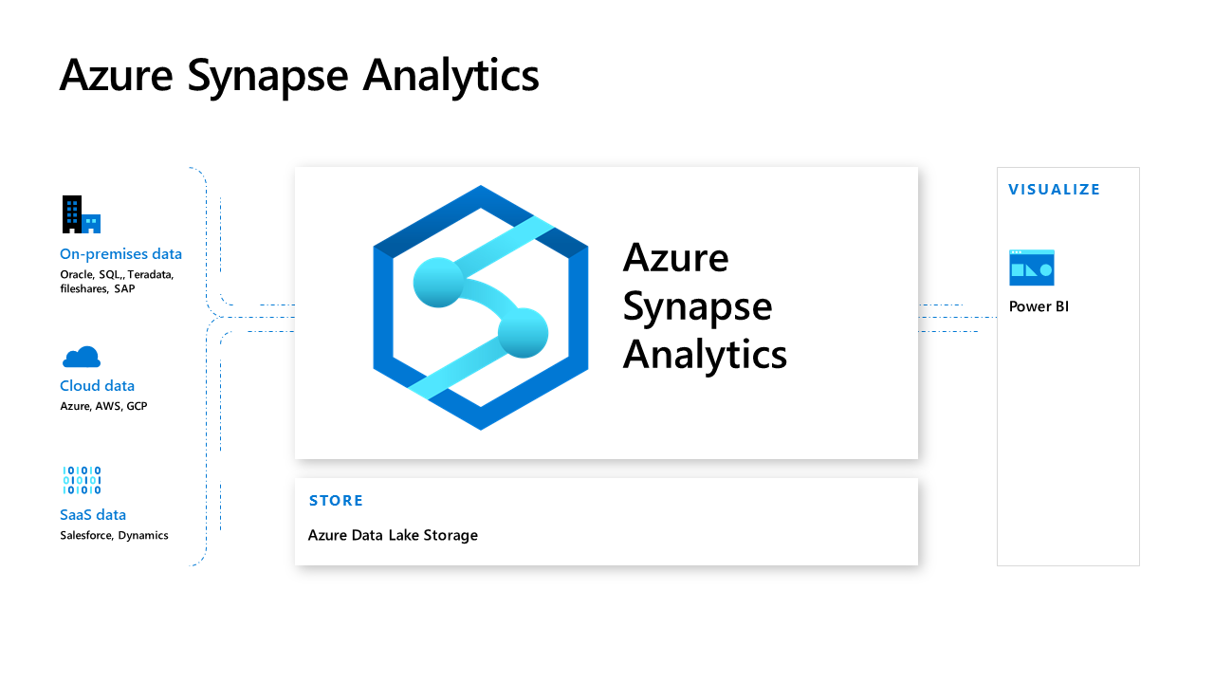
Evolution of Azure Data Warehouse
Azure Synapse
Azure Data Lake

Slide 11
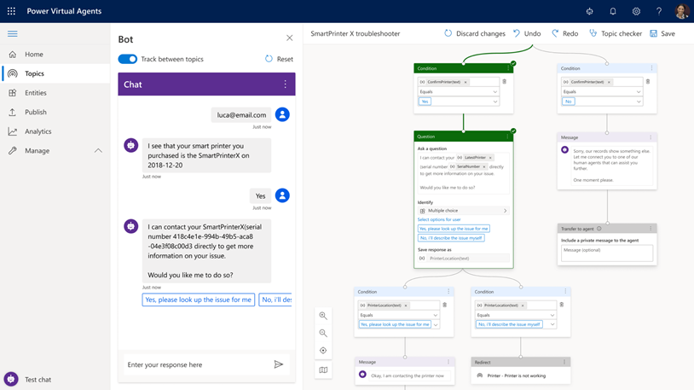
Alessandro – Microsoft Power Virtual Agents
Notes:
1: Address compliance issues by running your workloads on hosts dedicated to your Azure Tenant. Normally when you provision a VM, its on a multi-tenanted host right. So with other Azure customers workloads.
2: You can provision a host group and add dedicated hosts to it within a region or even an availability zone. Same applies for fault domains, so different racks, power etc within an Azure DC.
3: Windows Server Datacenter licenses and Software Assurance can use unlimited virtualization rights in Azure Dedicated Hosts.
4: Allows you to control the maintenance of your dedicated hosts – You currently have to apply to try this preview feature and can defer up to 35day before your forced to apply the maintenance.
5: A current limitation is your can only provision workloads from a particular VM family. You pick which one when you provision: ESv2 or DSv3.

Slide 12
Highlights
Get started in seconds
Empower your subject matter experts
Enable rich, natural conversations
Enable bots to take action
Microsoft Flow integration
Monitor and improve bot performance

Slide 13
Demo
Brazil Bot

Slide 14
Aben: Top Ten Security Practices on Azure
LORUM IPSUM!!
Notes:
1: Address compliance issues by running your workloads on hosts dedicated to your Azure Tenant. Normally when you provision a VM, its on a multi-tenanted host right. So with other Azure customers workloads.
2: You can provision a host group and add dedicated hosts to it within a region or even an availability zone. Same applies for fault domains, so different racks, power etc within an Azure DC.
3: Windows Server Datacenter licenses and Software Assurance can use unlimited virtualization rights in Azure Dedicated Hosts.
4: Allows you to control the maintenance of your dedicated hosts – You currently have to apply to try this preview feature and can defer up to 35day before your forced to apply the maintenance.
5: A current limitation is your can only provision workloads from a particular VM family. You pick which one when you provision: ESv2 or DSv3.

Slide 15
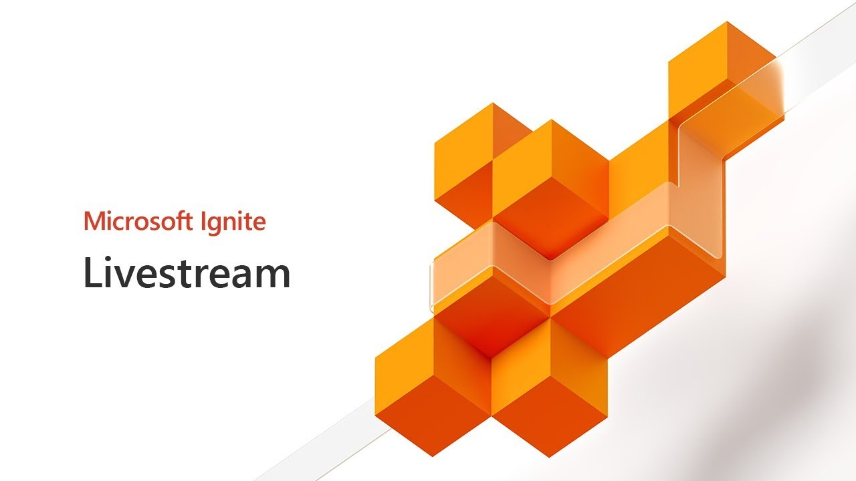
Wagner Silveira API Management Arc Enabled
Wagner Silveira

Slide 16
API management Arc Enabled
What it is?
Self Hosted API Gateway
Container Based
Supports Docker and Kubernetes Deployments
Control Plane in Azure (Arc)

Slide 17
API Management Arc Enabled
Features
Pick and choose the APIs to deploy
Custom Domains
Custom “Region”
Sync with control plane when connected
Works even without Connection to Azure
https://notetoself.tech/2019/11/17/api-management-arc-enabled/
Notes:
Event Grid on IoT Edge is now available in preview, allowing customers to adopt event-driven architectures on solutions created for disconnected environments or hybrid setups, bringing a powerful cloud application pattern to the edge. Using containers, the solution enables the pub-sub semantics available in Azure to work between modules within the same edge device and also between edge devices for disconnected environments, as well as sending events from the edge to the cloud for hybrid solutions.

Slide 18

Hands on time!

Slide 19
Sudhir: Mapping Dataflow in ADF
Notes:
1: Address compliance issues by running your workloads on hosts dedicated to your Azure Tenant. Normally when you provision a VM, its on a multi-tenanted host right. So with other Azure customers workloads.
2: You can provision a host group and add dedicated hosts to it within a region or even an availability zone. Same applies for fault domains, so different racks, power etc within an Azure DC.
3: Windows Server Datacenter licenses and Software Assurance can use unlimited virtualization rights in Azure Dedicated Hosts.
4: Allows you to control the maintenance of your dedicated hosts – You currently have to apply to try this preview feature and can defer up to 35day before your forced to apply the maintenance.
5: A current limitation is your can only provision workloads from a particular VM family. You pick which one when you provision: ESv2 or DSv3.

Slide 20
Jaliya Udagedara: Visual Studio Online
Visual Studio Online: Same Visual Studio Code experience you already know and love, only powered by the cloud
Features:
Full-fidelity development experience
Accessible from anywhere
Browser
Visual Studio Code
Visual Studio
Billed per usage

Slide 21



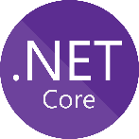
DSR: Azure Functions (if needed)
Azure Functions Premium GA
No cold start - pre-warmed instances
VNET integration
More powerful, customizable instances
Python 3.7 Support
.NET Core 3 support (Preview)
PowerShell Core in Azure Functions GA
Use existing PowerShell scripts/techniques/skills
Timer, HTTP & many more Azure Triggers
Can use PowerShell Gallery Modules
Very cheap (even free)
Integrate to ITIL, Power platform (MS Teams)
Supports authentication via Azure AD

Slide 22
DSR: Azure Functions (if needed)
Demo
PowerShell Core in Functions
Cleaning up Temporary Resource Groups on a Schedule
Idea shamelessly stolen from @JeffHollan

Slide 23
Q & A and Giveaways
Your opportunity to ask the presenters questions.
Each presenter will ask a question and the first person to answer will with a prize!

Slide 24
Slide Pack
20th November 2019
https://aka.ms/aaug

Slide 25
Some other Azure User Groups
Some other places to get your fix of Azure and Ignite!
Hamilton Azure User Group
Mini Ignite - Final Azure Meetup for 2019: Tuesday, November 26, 2019 4:30 PM – 6:30 PM @ SkyCity Hamilton
https://www.meetup.com/Hamilton-Microsoft-Azure-Meetup-Group
Azure Lunchtime Meetup
Microsoft Ignite 2019 - Lightning Talks: Monday, December 9, 2019 11:30 AM-1:30 PM @ Microsoft NZ
https://www.meetup.com/Auckland-Azure-Lunchtime-Meetup/events/266376036/

Slide 26
THE YEAR THAT WAS 2019
Notes:
That’s it, the last session of the year. I feel like its been a good one – Some new content topic saround IoT, integration, Express Route, Front Door sneak peeks, a LOT of governance talks and of course Kos from MSFT with his loose ask me anything no filter greatness last month!

Slide 27














Changing Of The Guard & Fresh Speakers
Notes:
One of the biggest things for us this year has been seeing some new faces get involved in speaking, organising, setting up and just generally being apart of the community.
For myself, Rory, Dan, Aben and the others we put these meetups on not just for us to present session or for our benefit
But for you guys and seeing new faces in the audience, having good yarns over beer and pizza
Getting fresh speakers stepping up to present is just really awesome!
So 2020 that is something we really want to keep pushing on.

Slide 28
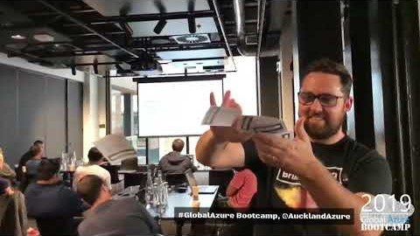
Global Azure Bootcamp 2019
Notes:
The bootcamp this year was a tough one to organize, we had to source new venues, fresh sponsors, fill more sessions with speakers and find merch!
Luckily we managed to do all that and learn a whole bunch about organising something of that scale along the way. Hopefully, we get to have the opportunity again next to run it here in AKL and hopefully some other similar events throughout the year as well with some help from Microsoft.
Part of the bootcamp was the Science lab – searching for stars using Azure container instances. We obviously got a head start over the rest of the world so as the day went on we dropped down the order
But I believe we finished up 7th in the world. Not bad for little old Auckland going up against the Madrids, London, Berlins of the world!

Slide 29
THE YEAR THAT WILL BE 2020
Notes:
Is largely TBC – We will aim to run the first meetup back in January or Feb depending on peoples movements.
But between now and then keep an eye open for some comms on meetup / Twitter for general news & happenings. Potentially some polls may go out to get some input from you guys on topics to start the year off with.
So other than that, have a great December, Christmas & New Year. We will hopefully see you guys in 2020.

